Slide 1
Collections

Slide 2
Agenda
Introduction to collections.
List
Set
Map
Example code

Slide 3
Introduction to Collections
Collections stores similar type of values in a container.
Collections in apex can be Lists, Sets or Maps.
There is no limit on the number of items a collection can hold. However, there is a general limit on heap size.
List | Set | Map
A list is an ordered collection. | A Set is an unordered collection. | A Map is a collection of key-value pair.
Can contain duplicate | Do not contain any duplicate | Each unique key maps to a single value. Value can be duplicate

Slide 4
List
List can hold any type of data like primitive, Sobject, Object etc.
List stores data in ordered form & allows duplicate entries.
Lists are iterable & sortable.
Index 0 | Index 1 | Index 2 | Index 3 | Index 4 | Index 5
'Red' | 'Yellow' | 'Green' | 'Blue' | 'Orange' | 'Red'

Slide 5
How to declare a List
1. List Constructors
List<T>()
List<T>(listToCopy)
List<T>(setToCopy)
2. Create a List
List<String> colorList = new List<String>();
List<String> colorList = new List<String>{'Red','Yellow','Green','Blue','Orange'};
String [] colorList = new String[10];
3. Create a nested List
List<List<Contact>>> contactNestedList = new List<List<Contact>>();

Slide 6
Methods in List
Sr.No. | Method Name | Syntax | Use
1. | add(listElement) | colorList .add('Red'); | Adds an element to the end of the list.
2. | add(index,listElement) | colorList .add(0,'Yellow'); | Inserts an element into the list at the specified index position.
3. | get(index) | colorList .get(2); | Returns the list element stored at the specified index.
4. | equals(colorList2) | colorList .equals(colorList2); | Compares this list with the specified list and returns true if both lists are equal; otherwise, returns false.
5. | clear() | colorList .clear(); | Removes all elements from a list, consequently setting the list's length to zero.
Link : List methods

Slide 7
Set
Sets can hold any type of data like primitive, Sobject, Object etc.
Sets stores data in unordered form & doesn't allows duplicate entries.
Uniqueness of the data respects case sensitivity.
Sets are iterable & already sorted.
7400 | 7401 | 7402 | 7403 | 7404 | 7405

Slide 8
How to declare Set
1. Set Constructors
Set<T>()
Set<T>(setToCopy)
Set<T>(listToCopy)
2. Create an empty Set
Set<Integer> employeeIdSet = new Set<Integer>();
Set<Integer> employeeIdSet = new Set<Integer>{'7401','7402','7403','74014','7405'};

Slide 9
Methods in Set
Sr.No. | Method Name | Syntax | Use
1. | add(setElement) | employeeIdSet.add('7400'); | Adds an element to the Set if it is not already present.
2. | remove(setElement) | employeeIdSet.remove('7400') | Removes the specified element from the Set if it is present.
3. | addAll() | employeeIdSet.addAll(employeeIdList) | Adds all of the elements in the specified list to the set if they are not already present.
4. | clear() | employeeIdSet.clear() | Removes all of the elements from the set
5. | contains() | employeeIdSet.contains('7400') | Returns true if the set contains the specified element.
Link : Set methods

Slide 10
Map
A Map is a collection of key-value pair.
Value can hold any type of data like primitive, Sobject, Object etc. But key can hold only primitive data type.
Maps are non-iterable & non-sortable.
Emp_Id (Key) | 7400 | 7401 | 7402 | 7403 | 7404
Emp_Name (Value) | 'Bhagyashri' | 'Shreya' | 'Shubham' | 'Shubhankar' | 'Niharika'

Slide 11
How to declare Map
1. Map Constructors
Map<T1, T2>()
Map<T1, T2>(mapToCopy)
Map<Id, Sobject>(recordList)
2. Create an empty Map
Map<Id, String> empIdVsEmpName = new Map<Id, String>();
3. Create a map & fill it using SOQL query
Map<Id, Employee> empIdVsEmpName = new Map<Id, Employee>([SELECT Id, Name FROM Employee WHERE Name Like %BFL%]);

Slide 12
Methods in Map
Sr.No. | Method Name | Syntax | Use
1. | put(key) | empIdVsEmpName.put(Key, Value); | Associates the specified value with the specified key in the map
2. | get(key) | empIdVsEmpName.get(Key); | Returns the value to which the specified key is mapped, or null if the map contains no value for this key.
3. | keySet() | empIdVsEmpName.keySet(); | Returns a set that contains all of the keys in the map.
4. | values() | empIdVsEmpName.values(); | Returns a list that contains all the values in the map.
5. | size() | empIdVsEmpName.size(); | Returns the number of key-value pairs in the map.
Link : Map methods

Slide 13
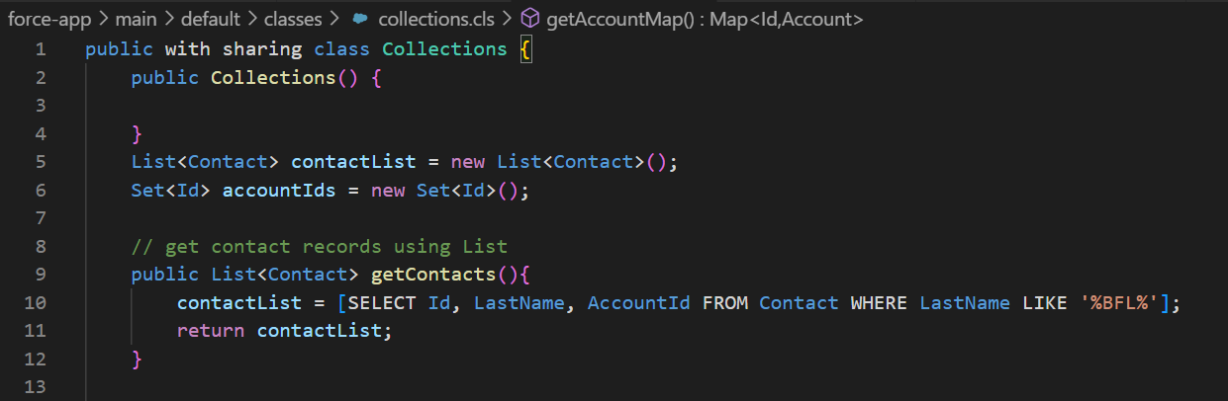
Example code
Get contact records using List

Slide 14
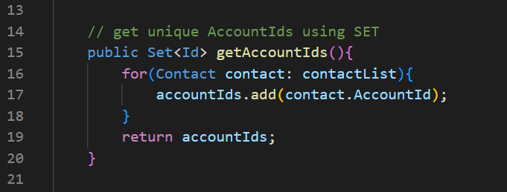
Example code
Get unique Account Ids using Set

Slide 15
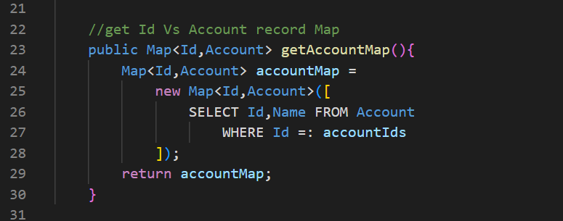
Example code
Get Id Vs Account record using Map

Slide 16
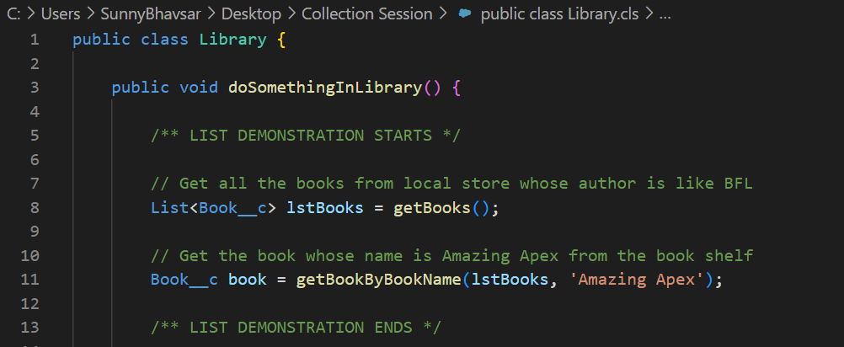
Real time scenario of Books and its placement in Library.

Slide 17
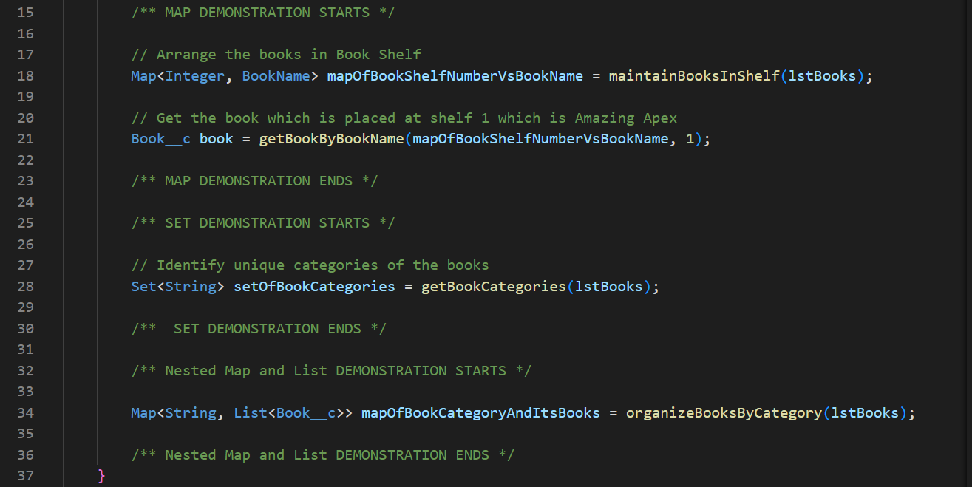
Real time scenario of Books and its placement in Library.

Slide 18
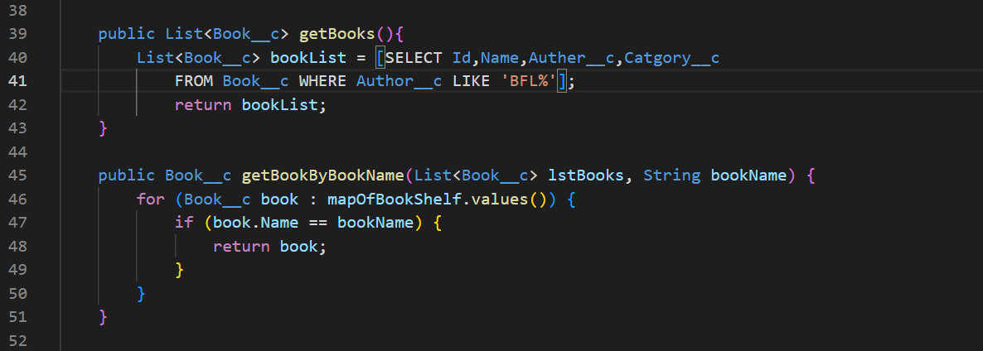
Real time scenario of Books and its placement in Library.

Slide 19
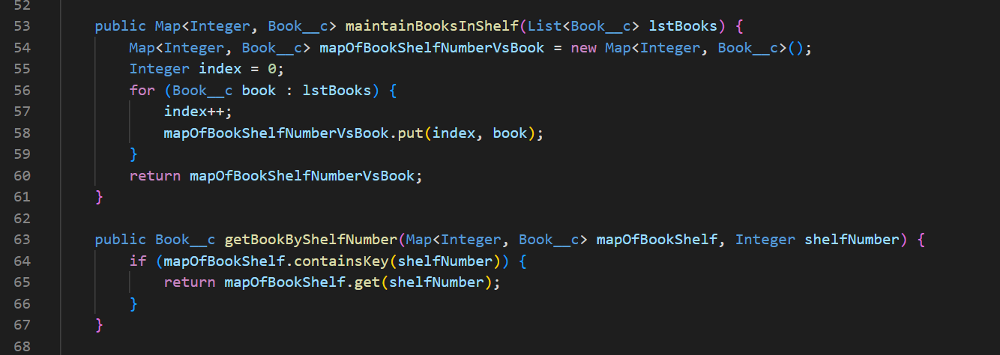
Real time scenario of Books and its placement in Library.

Slide 20
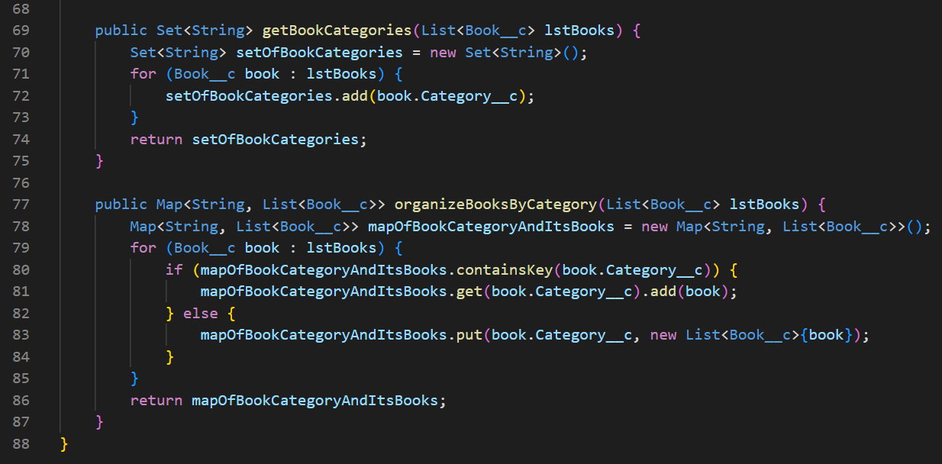
Real time scenario of Books and its placement in Library.

Slide 21
Nested Collections
Map<Id, List<String>>
Map<Id, List<Account>>
List<List<Sobject>>
Map<String, Set<String>>
Map<String, Map<String,List<MyClass>>

Slide 22
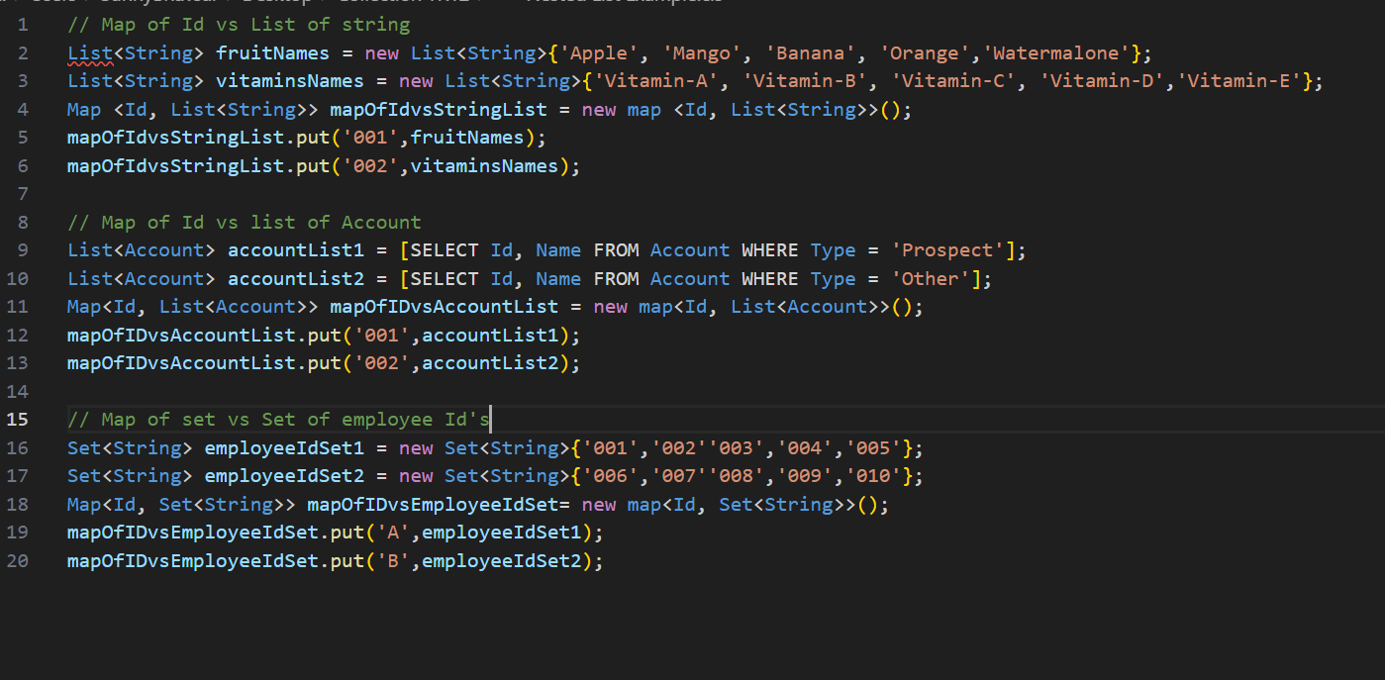
Nested Example

Slide 23
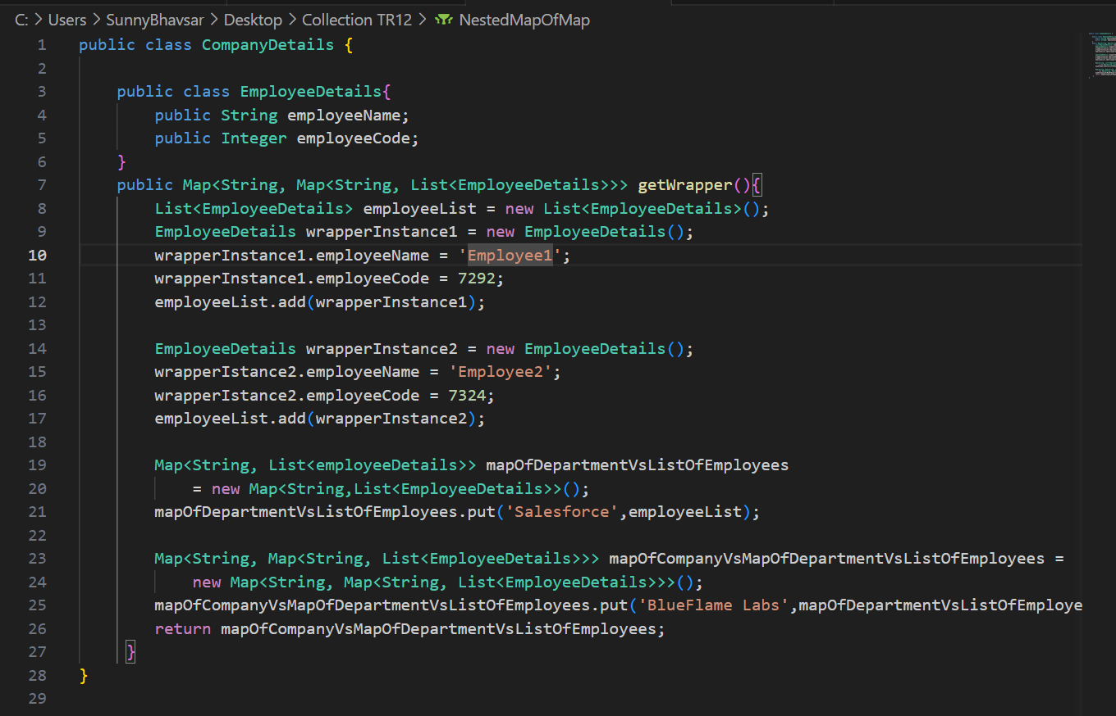

Slide 24

THANK YOU
Any questions?

